Slide 1
Welcome!

Slide 2
Our Mission & Vision
We believe in a life of opportunity, of choice and of dignity for every individual, regardless of age or ability.
Our mission is to advocate for and empower individuals with disabilities to lead lives of their choice.

Slide 3
A Brief History
In 1972, the Foothills Activity Center of Loveland merged with the Easter Seals Gateway Center in Fort Collins, thus becoming FOOTHILLS GATEWAY.
Over our 45 years, we have improved the lives of thousands of people with intellectual and developmental disabilities by helping to conquer challenges and achieve their maximum potential.

Slide 4
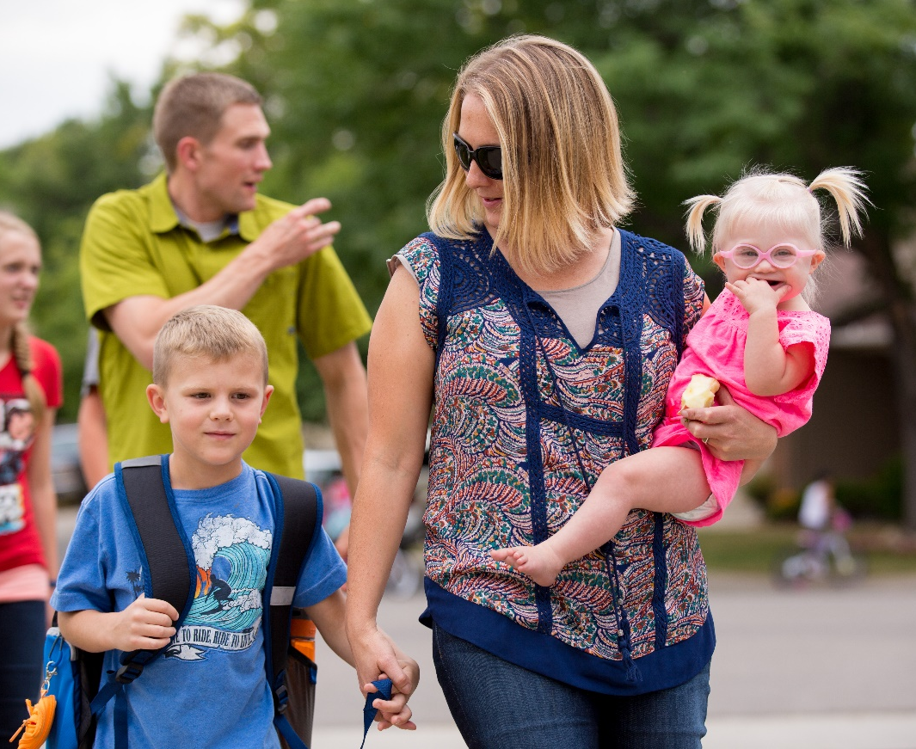
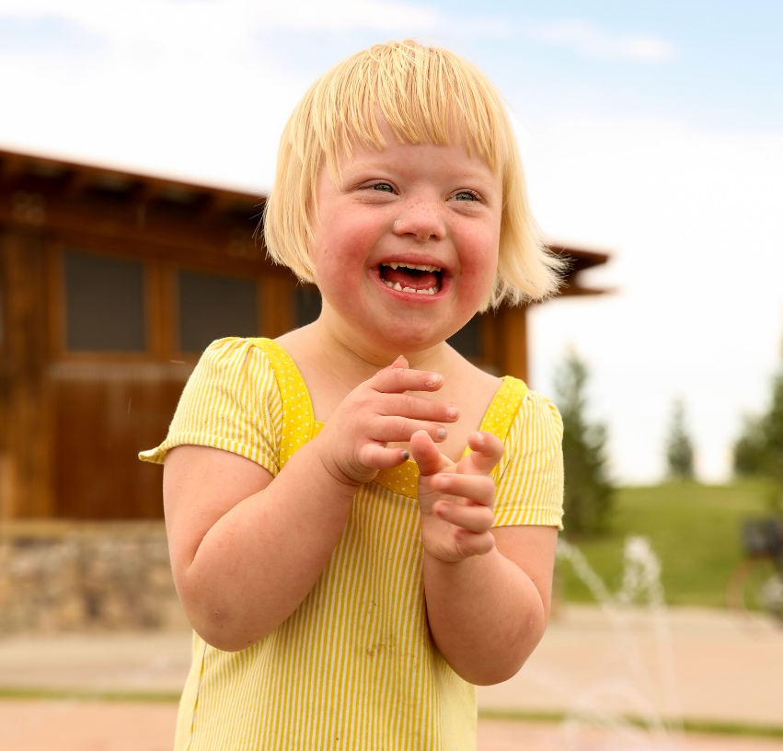
What We Do
We provide case management within 15 different programs and waivers, plus 9 direct support services.
Programs range from Early Intervention and Family Support to Transportation and Vocational services.

Slide 5
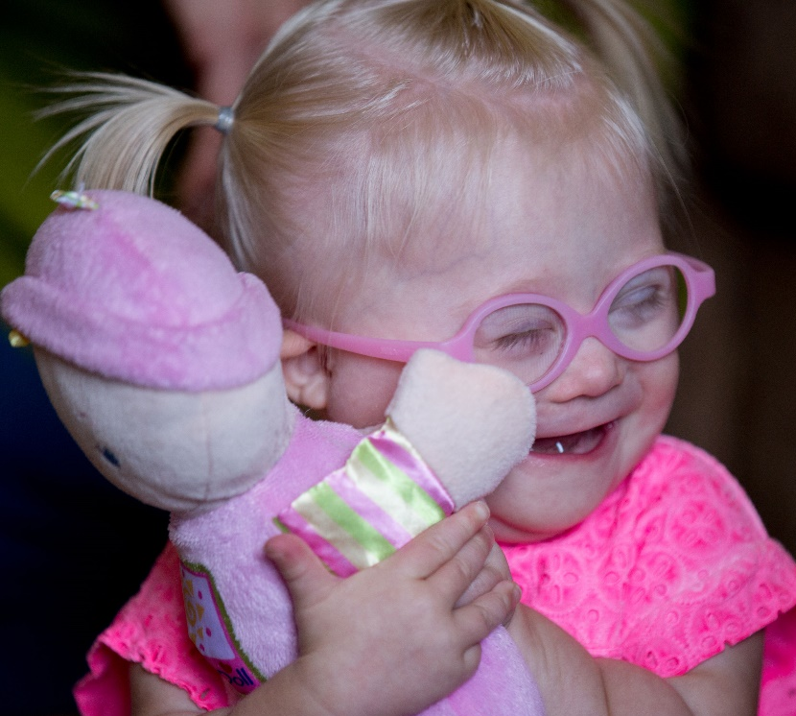
Children’s Programs
80% of Early Intervention participants don’t need our services after age 3!
Early Intervention
Serving families with children 0-3 years-old who have developmental delays or disabilities.
Goal: to provide intervention therapies, including occupational, speech and physical, in the home to better prepare children for preschool.

Slide 6
Children’s Programs
Children’s Home and Community Based Services
Serving families with children 0-17 years-old, who are at risk of nursing facility or hospital placement.
Goal: to provide Medicaid benefits in the home or community to children who would otherwise be ineligible due to excess parental income and/or resources.

Slide 7
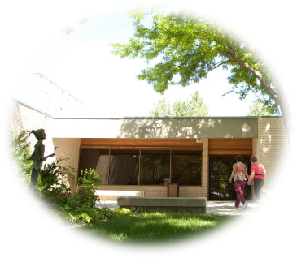
Children’s Programs
Autism Waiver
Serving families with children 0-5 years-old, who have been diagnosed with Autism with intensive behavioral needs that are at risk of institutionalization
Goal: to provide Medicaid benefits in the home or community to children who are most in need due to the severity of their disability.
The Autism Waiver is a State-Wide program with a 75 person capacity

Slide 8
Children’s Programs
Children’s Extensive Support
Serving families with children 0-17 years-old, with intensive behavioral or medical needs who are at risk of institutionalization.
Goal: to provide Medicaid benefits in the home or community to children who are most in need due to the severity of their disability.

Slide 9
Family Support & Services Program
Serving families that have one or more family member of any age with a intellectual/developmental disability living in the family home.
Goal: to provide information, support, coordination and funding, ensuring the best at-home circumstances possible.
Funding from FSSP can be put toward respite, adaptive equipment, home modification and more.

Slide 10
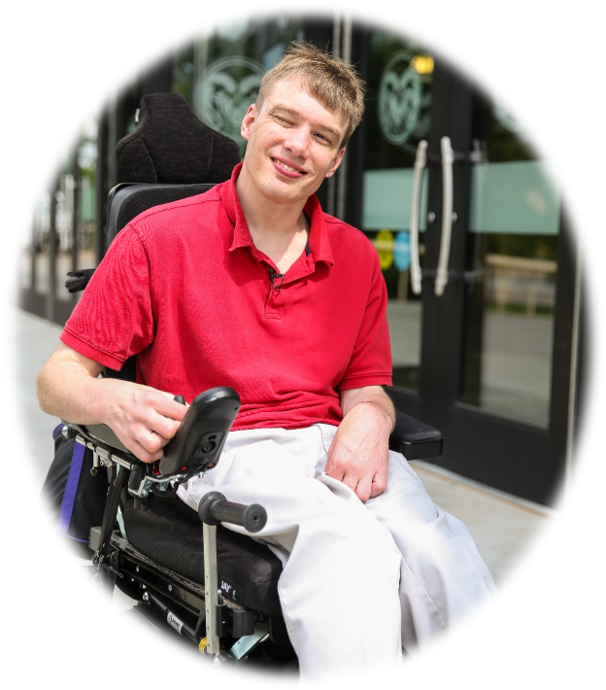
Adult Programs
Comprehensive Services
Serving adults 18-years or older, with intellectual/developmental disabilities that need 24-hour care.
Goal: to provide 24-hour, 7-day a week care defined by individual support plans.

Slide 11
Adult Programs
Supported Living Services
Serving adults 18-years or older, with intellectual/developmental disabilities who require supports to live as independently as possible.
Goal: to enable adult participants to make choices, receive needed services and live more independently in their own home or in the family home.
Services available include: case management services, personal care services, supported employment services, respite and day program services.

Slide 12
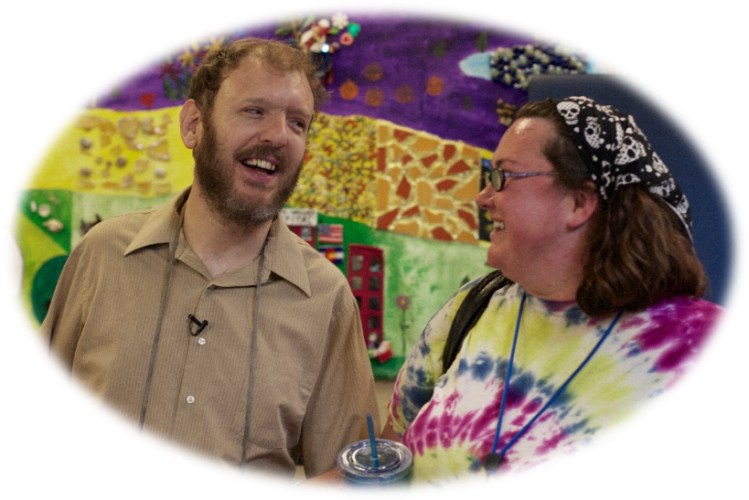
Adult Programs
Direct Support Services @ Foothills Gateway
Services provided to adults on-site include:
Special Habilitation
Community Connections
Vocational opportunities
Supported Employment
Transportation

Slide 13
Total by the Numbers
Foothills Gateway has served over 2,600 individuals and their families in the last year.
There are currently 1,217 individuals and families waiting for services, 348 of which have an immediate need.
Colorado ranks 48th in the U.S. for I/DD funding, and
yet we consistently rank top 10 for quality of services!

Slide 14
Where does the money come from?
6%
23%
71%
*Foothills Gateway operates with only 9% overhead*

Slide 15
Thank You!

